Slide 1



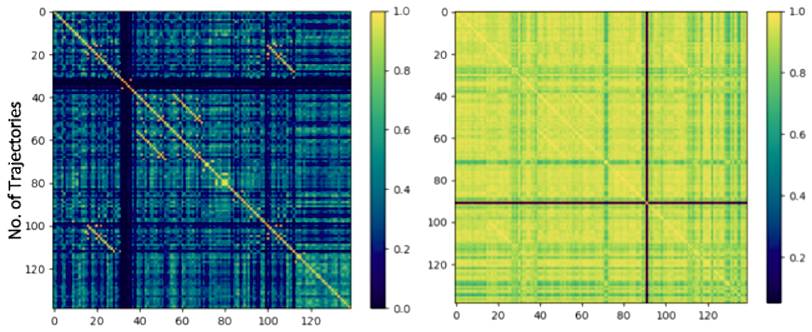
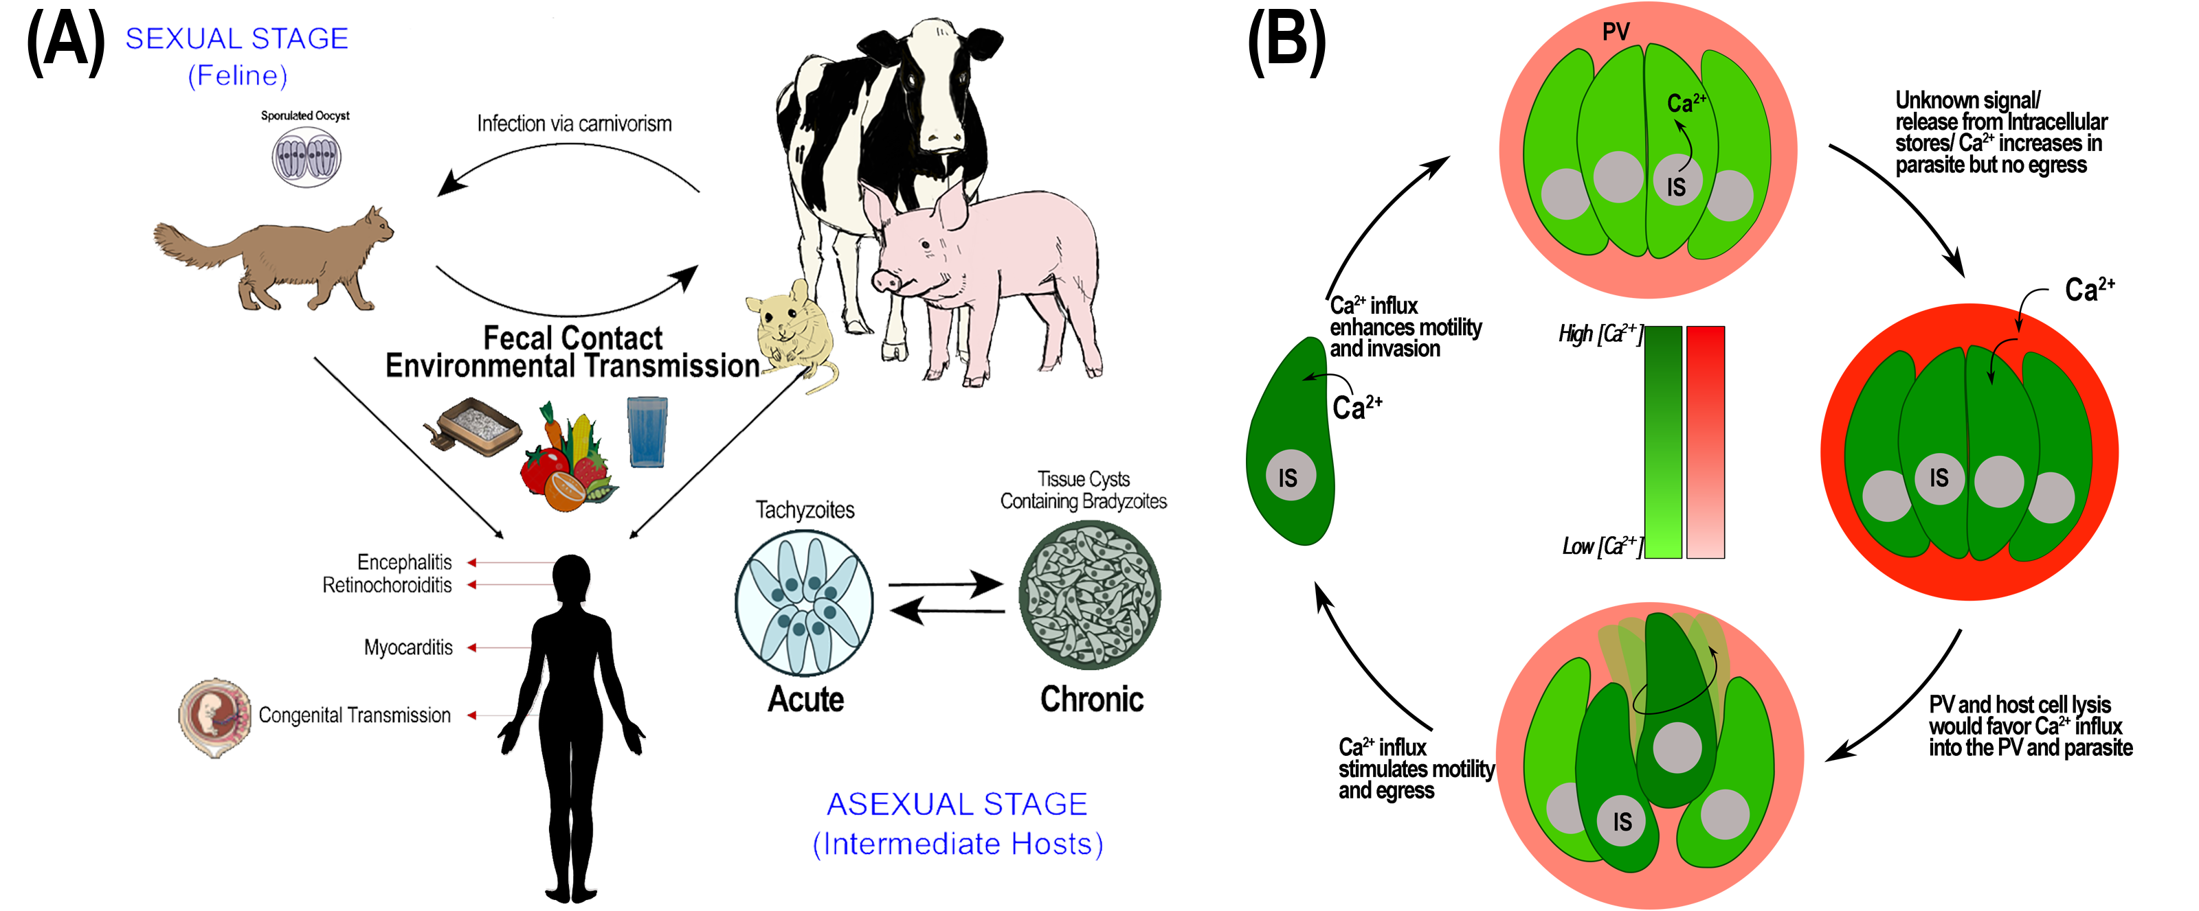
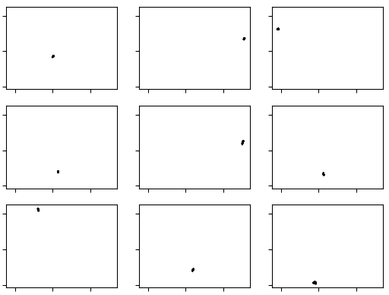
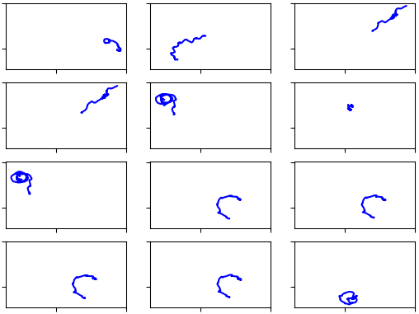
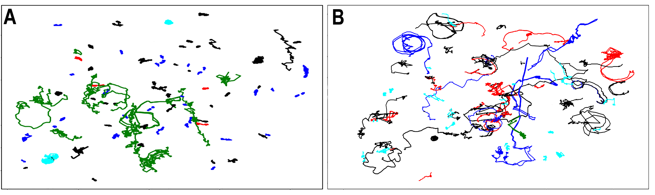
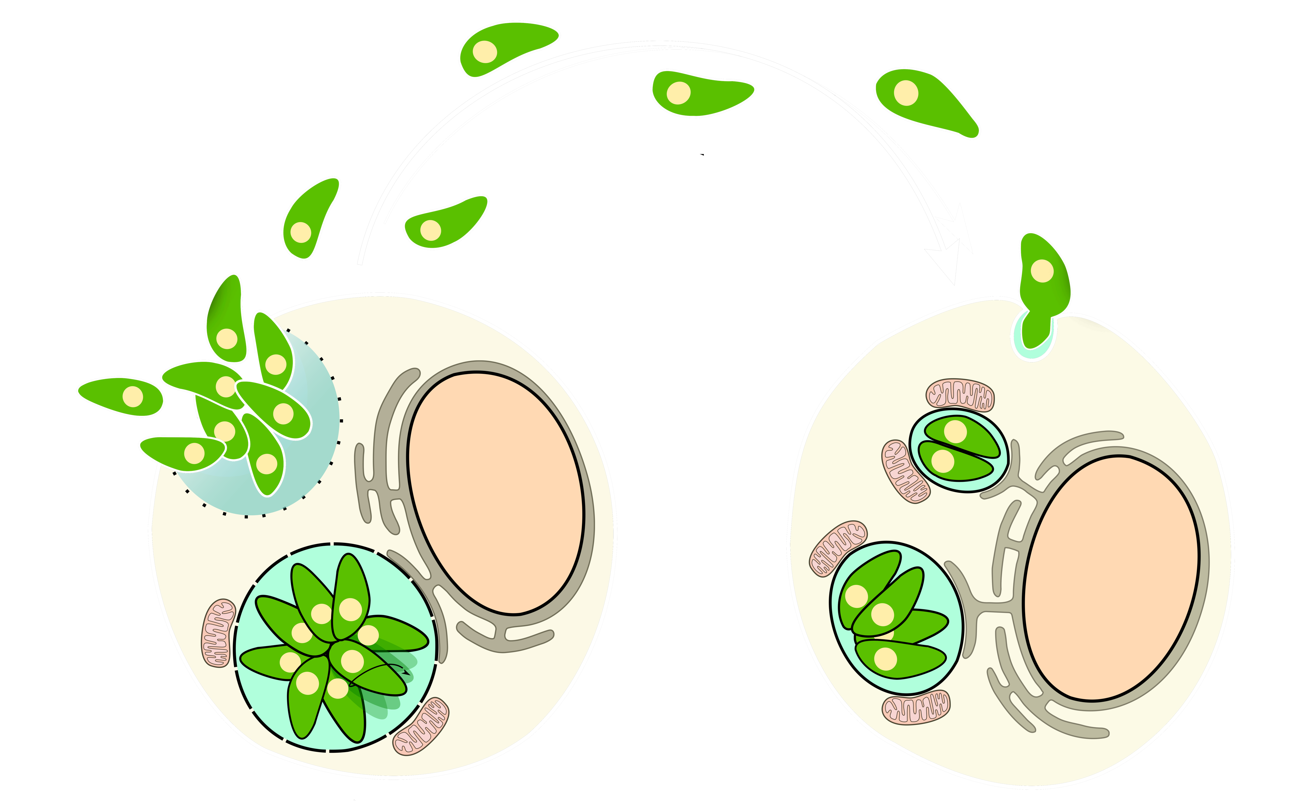
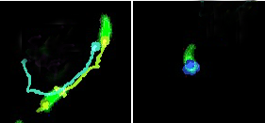
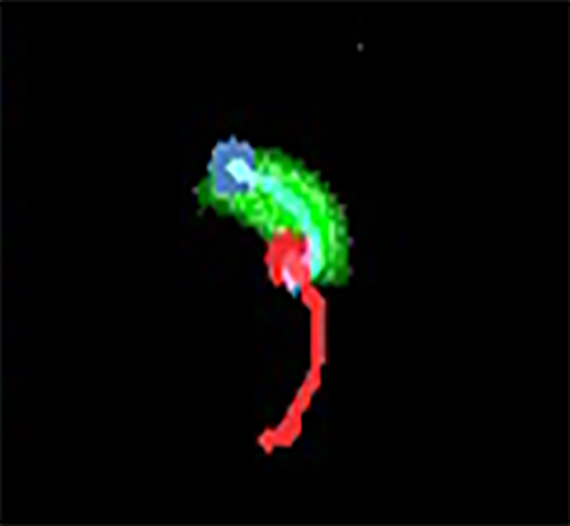
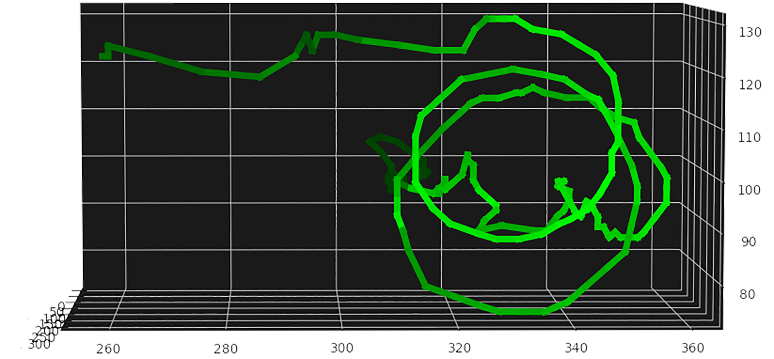
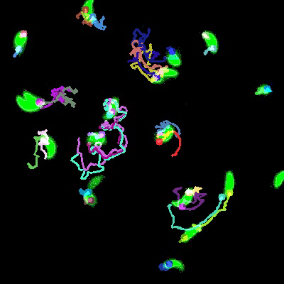
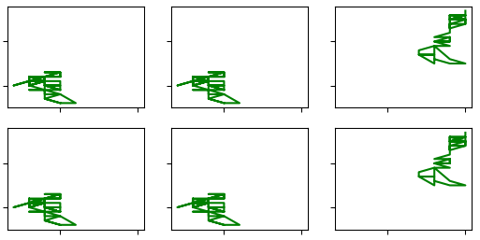
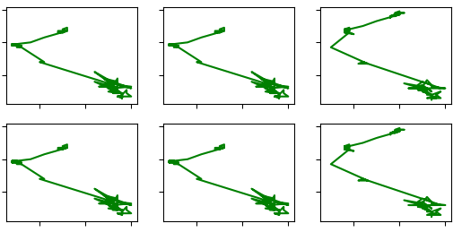
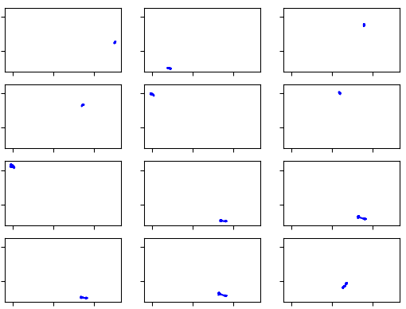
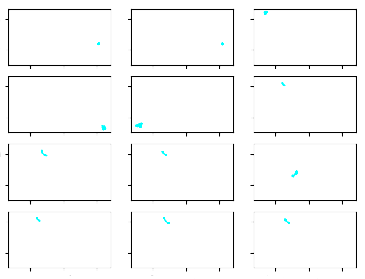
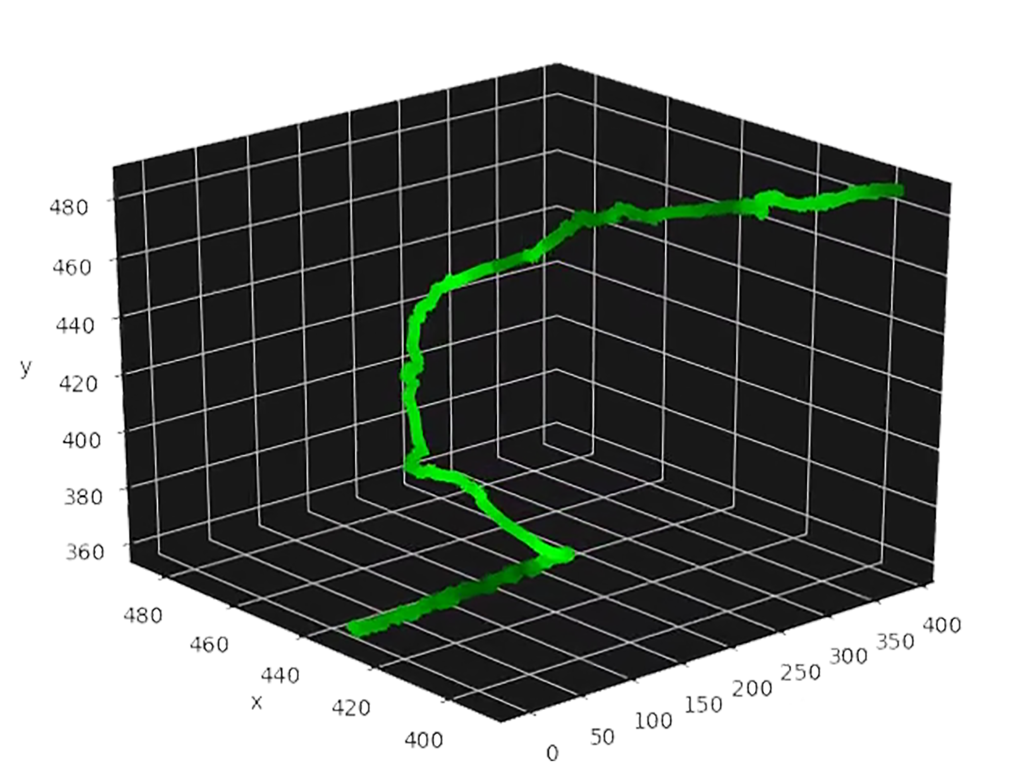
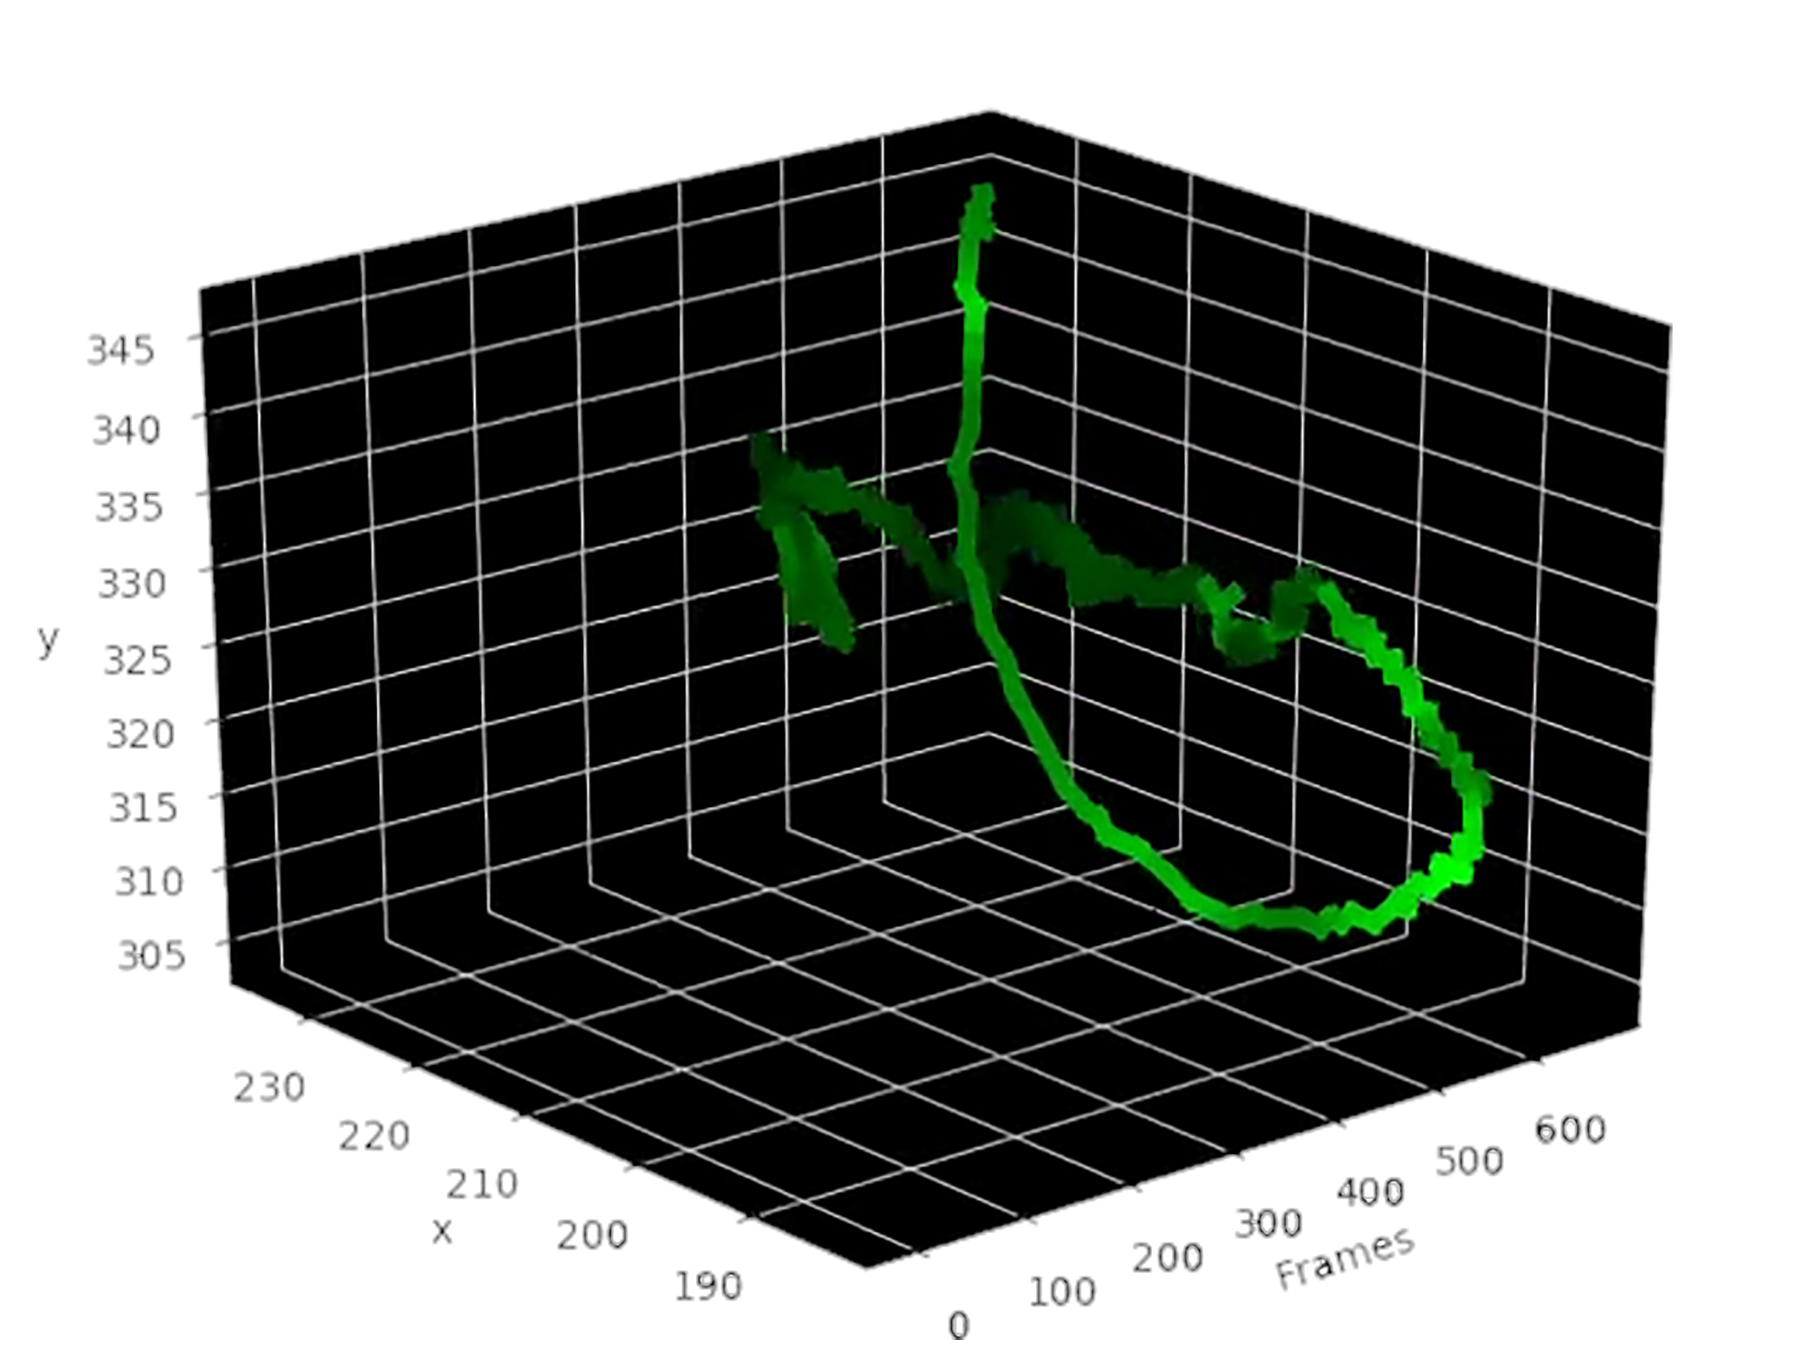
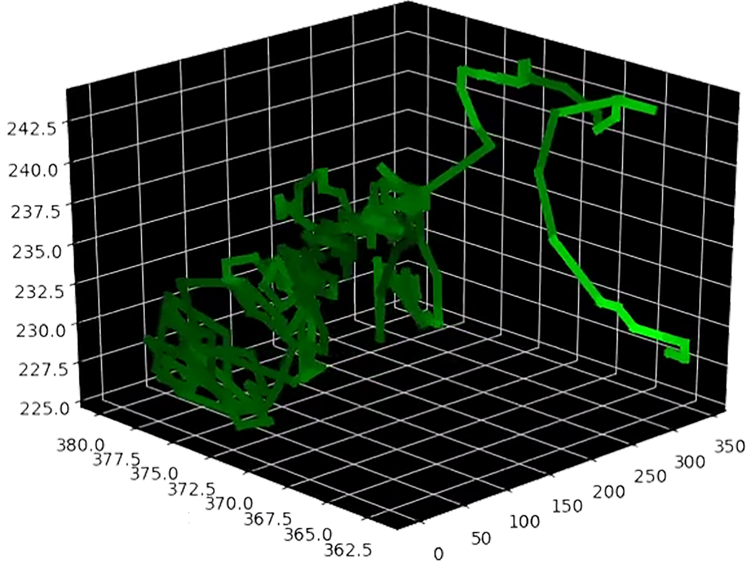
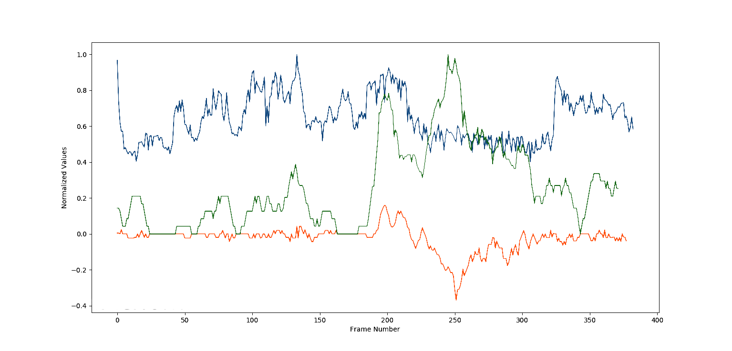
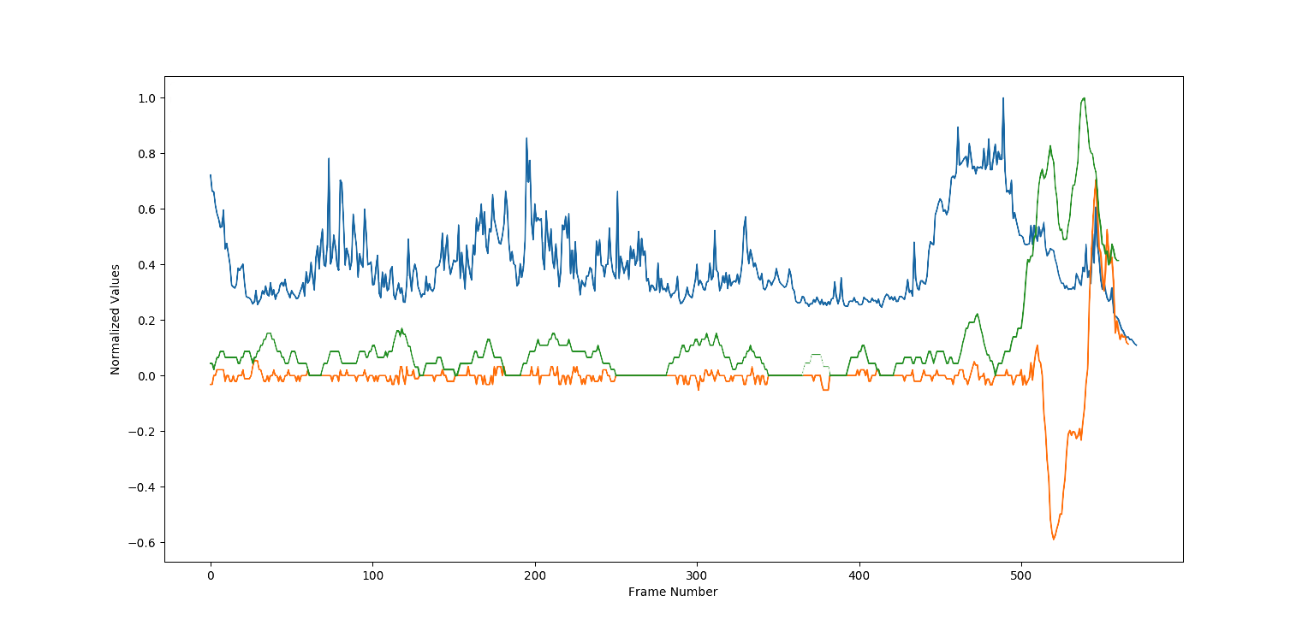
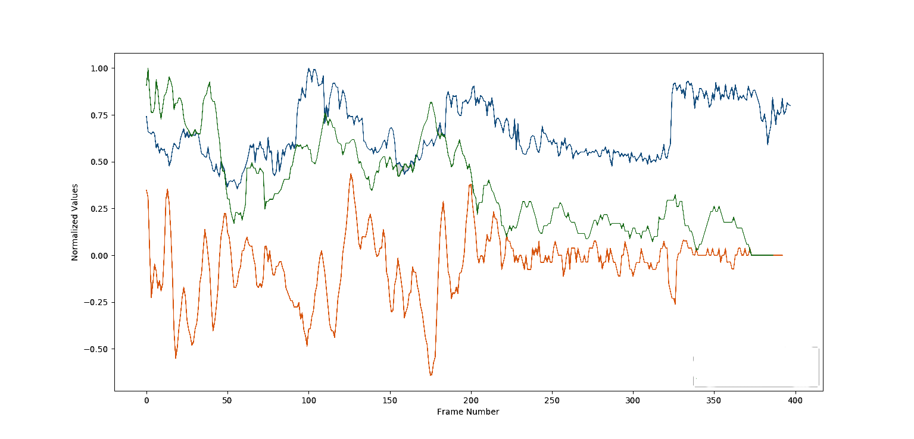
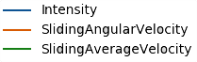
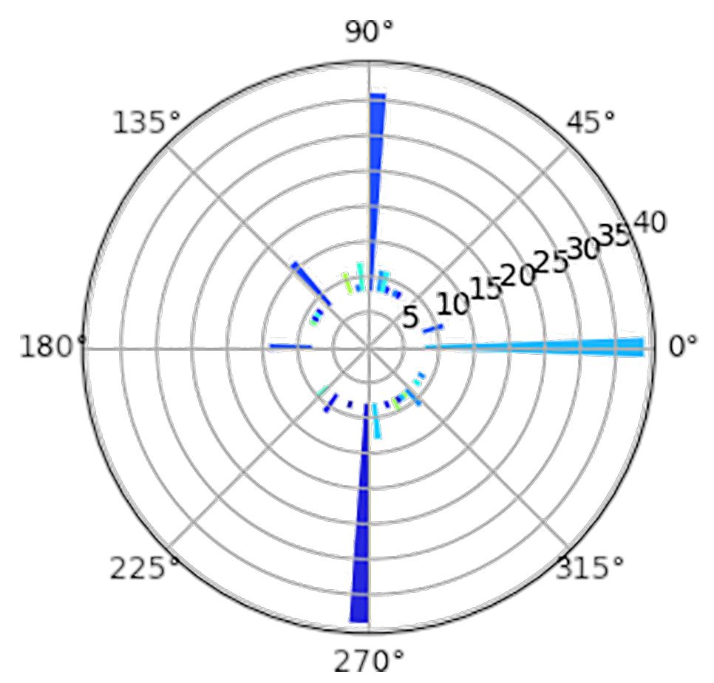
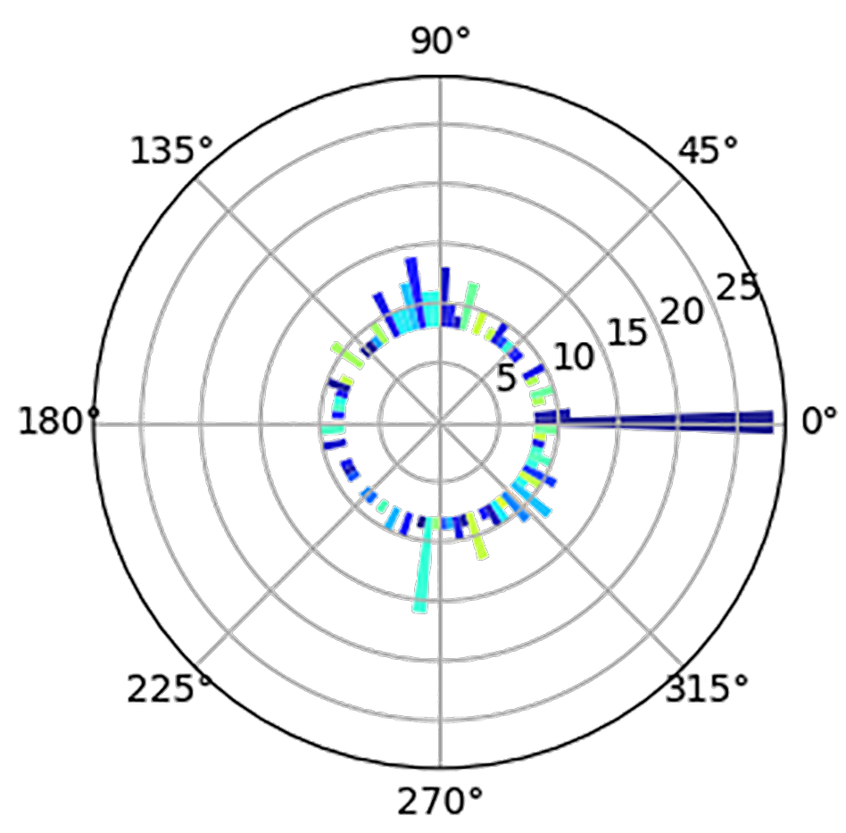
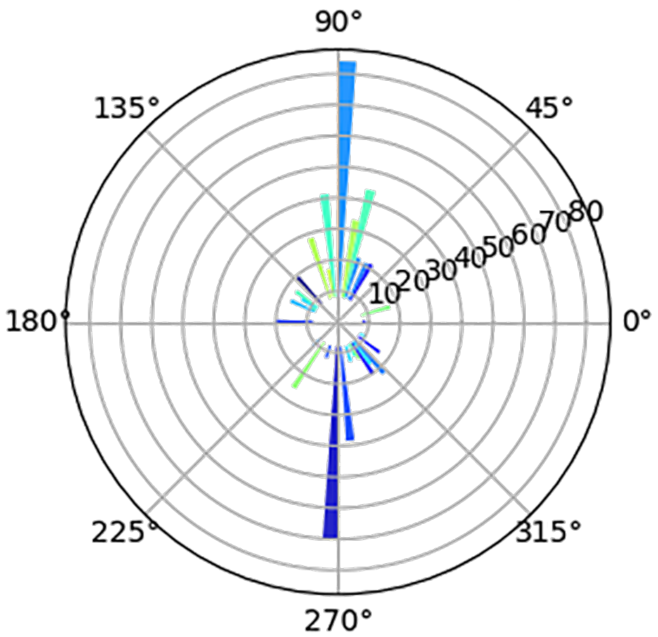
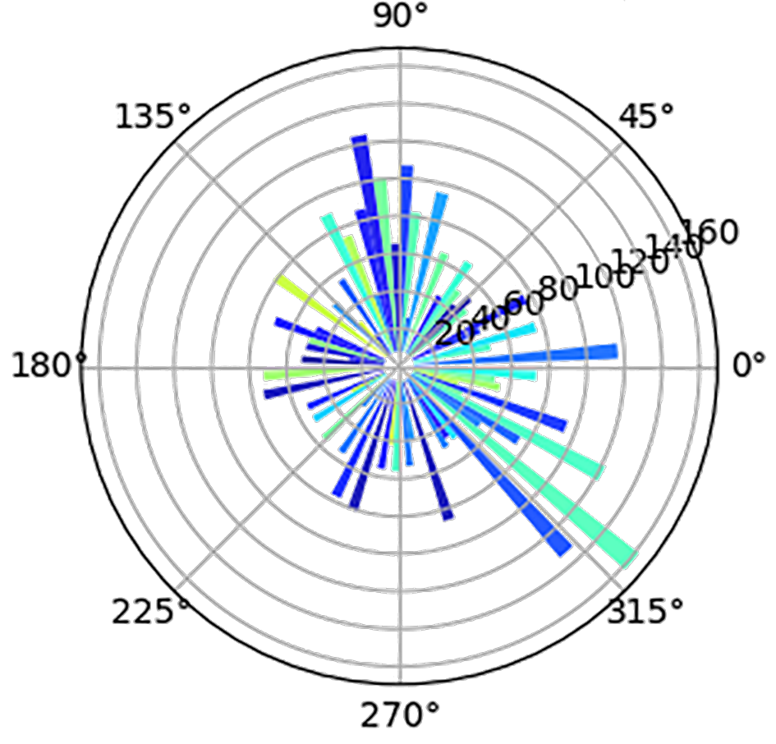
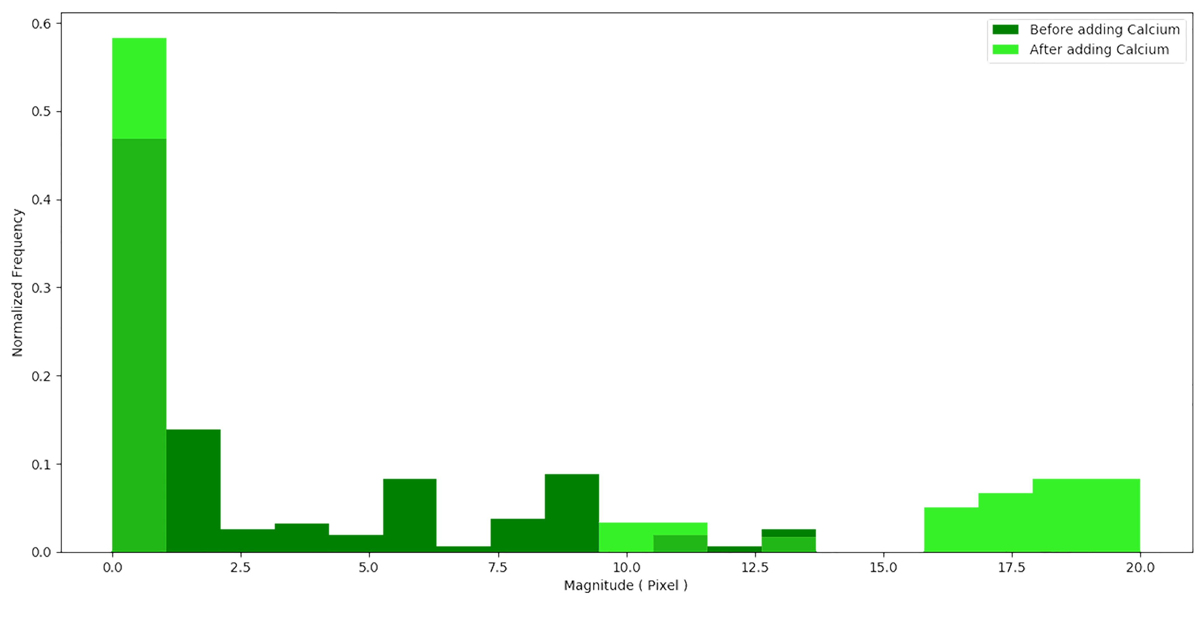
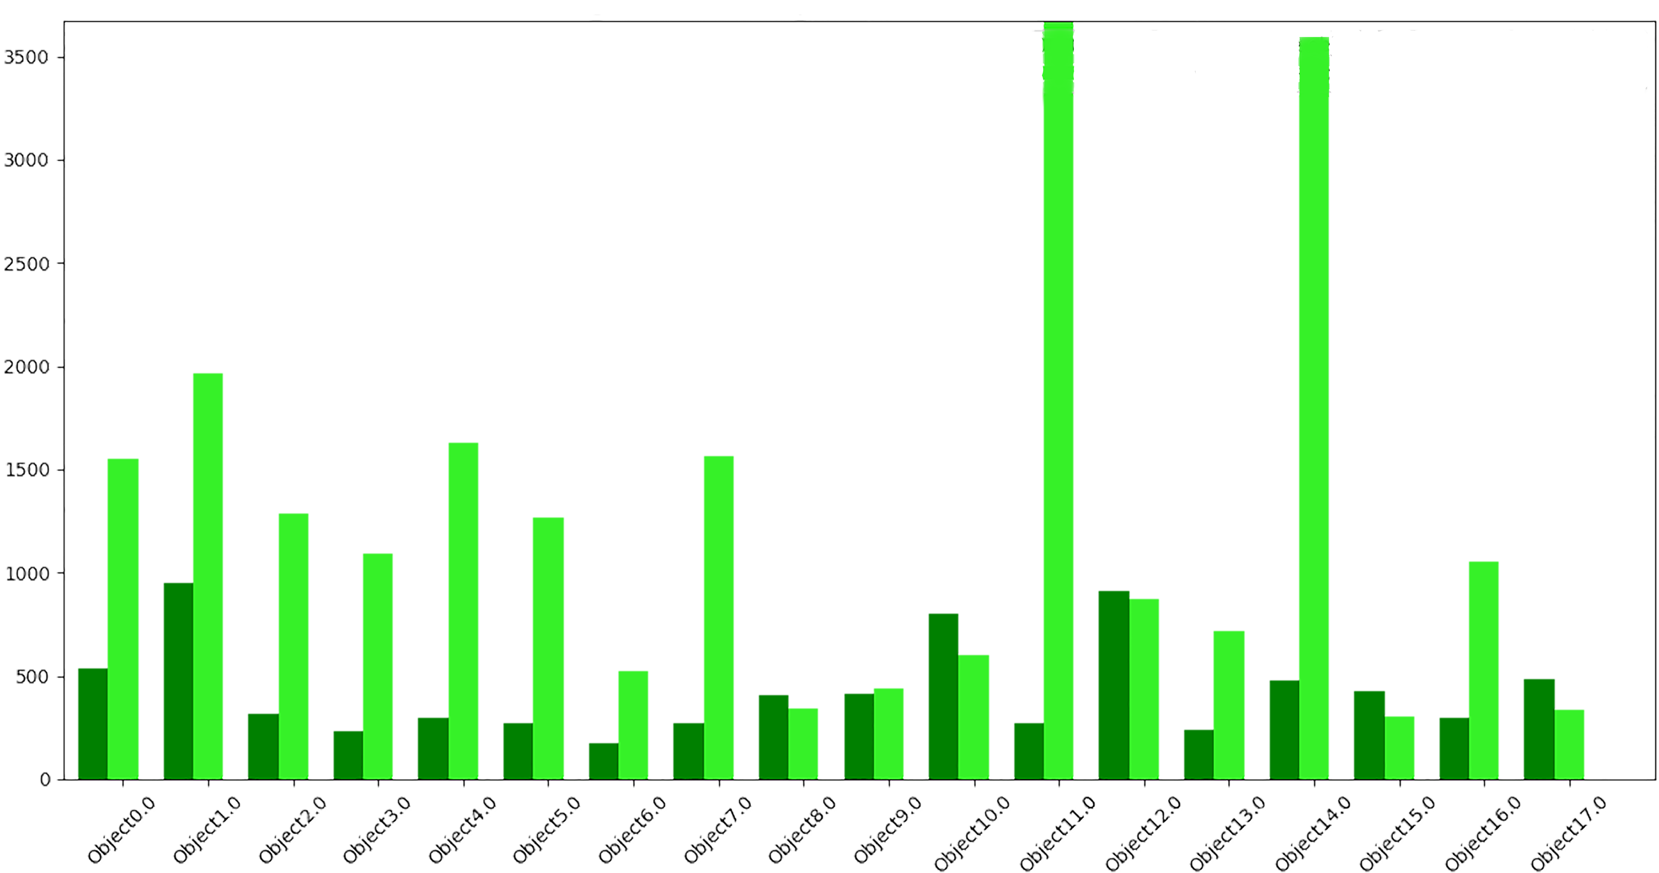
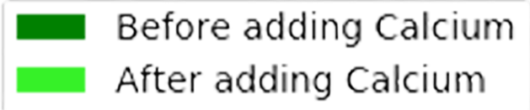
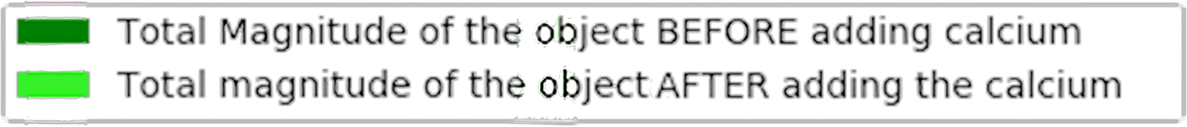
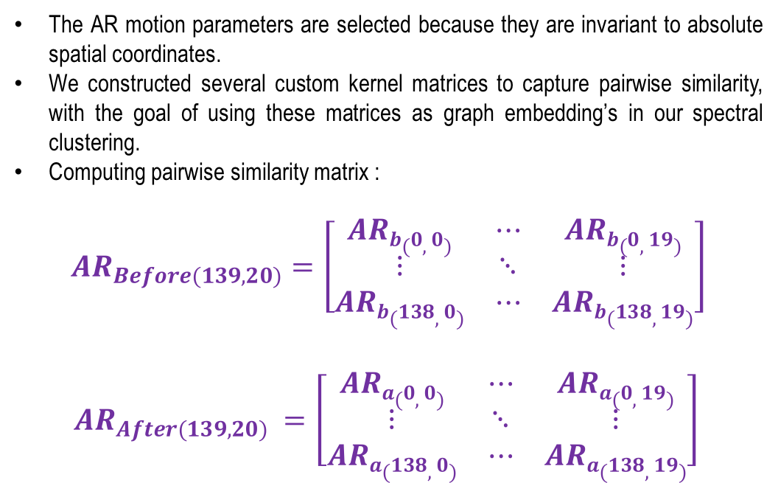
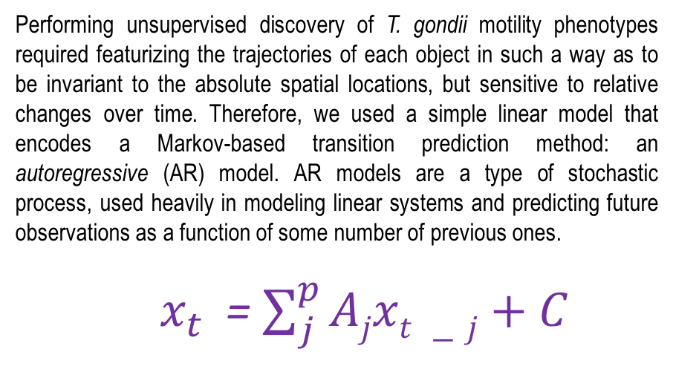
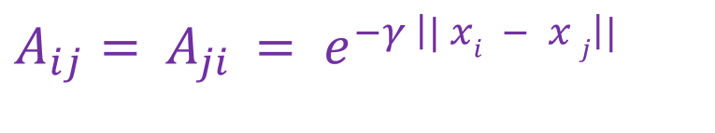
Modeling the Motion of Toxoplasma gondii
Mojtaba S. Fazli*, Stephen Vella**, Andrew Durden, Silvia N.J. Moreno**, Shannon Quinn*,**
*Department of Computer Science, University of Georgia
**Department of Cellular Biology Center for Tropical and Emerging Global Diseases, University of Georgia,
Athens, Georgia 30605, United States of America
Abstract:
Pipeline:
Establishing Pairwise Motion Similarity
Toxoplasma gondii is a parasitic protozoan that causes disseminated toxoplasmosis, a disease that afflicts roughly a third of the world’s population. Its virulence is predicated on its motility and ability to enter and exit nucleated cells. As such, studies elucidating its mechanism of motility and in particular, its motility patterns in the context of its lytic cycle, are critical to the eventual development of therapeutic strategies. Here, we present an end-to-end computational pipeline for identifying T. gondii motility phenotypes in a completely unsupervised, data-driven way. We track the parasites before and after addition of extracellular Ca²⁺ to study its effect on parasite motility patterns. We use this information to parameterize the motion and group it according to similarity of spatiotemporal dynamics.
Figure 3) Broadly, we imported 10 videos, preprocessed them, and extracted the motility statistics, and parasite trajectories using our tracking algorithm.
Then we used a linear model that encodes a Markov based transition prediction method: an autoregressive (AR) model which represents a parameterization of the system that is not sensitive to absolute spatial position. In next step the similarity matrix is created and finally the spectral clustering is applied to group the similar motion trajectories.
Raw Videos Data
The AR motion parameters are selected because they are invariant to absolute spatial coordinates.
We constructed several custom kernel matrices to capture pairwise similarity, with the goal of using these matrices as graph embedding’s in our spectral clustering.
Computing pairwise similarity matrix :
$${AR}_{Before(139,20)}=\left[\begin{matrix}ARb(0,0) & ⋯ & ARb(0,19) \\ ⋮ & ⋱ & ⋮ \\ ARb(138,0) & ⋯ & ARb(138,19)\end{matrix}\right]$$
$${AR}_{After(139,20)} =\left[\begin{matrix}ARa(0,0) & ⋯ & ARa(0,19) \\ ⋮ & ⋱ & ⋮ \\ ARa(138,0) & ⋯ & ARa(138,19)\end{matrix}\right]$$
Optical Flow-
KLT Tracker
Preprocessing
Life Cycle and Ca²⁺ Homeostasis of T. gondii:
Extraction of Trajectories
Statistical Analyzation
A
B
Preprocessing on trajectories
Auto regressive Parameterization
Figure 4 : RBF kernels from AR motion parameters using gamma = 0.1, from AR motion parameters computed before (left) and after (right) addition of cytosolic Ca²⁺.
Spectral Clustering
We then computed pairwise “affinities”, using the radial-basis function (RBF) or Gaussian kernel:
Similarity Matrix
$A_{ij}=$ $A_{ji }= e^{−γ \left|| xi − x j\right||}$
Results!
Spectral Clustering of the Motion Phenotypes
How Can We Study
The Motion Model
in a Live, Motile
Parasite?
Spectral clustering :
Operates on the spectrum of the underlying graph of the data, imposed through a similarity computation using a pairwise kernel.
First, using this affinity kernel, a graph Laplacian is computed.
Second, the principal eigenvectors of that graph are used to embed the original data in a low-dimensional space
Now we can use the simpler clustering strategies such as K-means to separate the groups.
Using established heuristics from previous work on the T. gondii parasite and its lytic cycle, we chose k = 5 clusters for our analysis.
A
B
C
Figure 1 A) Toxoplasma Life Cycle. Sexual replication only occurs within cats. Sporulated oocysts are shed into the environment via cat feces. Within intermediate hosts, such as humans, tachyzoites account for acute infection. Bradyzoites are formed from tissue cysts and contribute to life-long infection. Uncontrolled lytic cycle growth can cause secondary complications. (Image adapted from Christina Moore). B) Model of Ca²⁺ Homeostasis. Increases in intracellular Ca²⁺ stimulate lysis of host cell, causing Ca²⁺ influx from the extracellular media. Influx of Ca²⁺ leads to an activation of motility and egress. Parasites that egress seek other host cells to invade thus continuing with its lytic cycle via gliding motility. Adapted from Borges et al. 2015
KLT Tracking of Ca²⁺ Dynamics
Egress
Invasion
(I)
(II)
Helical
Circular
Twirling
A
Ca²⁺
Y
Y
Ca²⁺
Y
Ca²⁺
Helical
TG
Circular
Ca²⁺
Twirling
Ca²⁺
B
Helical
Circular
Twirling
C
Ca²⁺
TG
TG
Ca²⁺
Y
Normalized Values
X
Frames
X
Frames
X
Frames
Frames
Frames
Frames
Figure 5 A) Clustering results of trajectories before (left column) and B) after (right column) addition of extracellular Ca²⁺. Three sample clusters are shown in each column. C) Aggregated plotting of trajectories before (top) and after (down) addition of extracellular Ca²⁺. Each object is colored by its cluster identifier, and placed according to its original absolute spatial location.
D
+ Ca²⁺
E
+ Ca²⁺
F
Normalized Frequency
Magnitude (total pixels / video)
Parametrization of normalized KLT Trajectories
Magnitude (Pixels)
Conclusions/Future Directions
Unweighted
Weighted
Object No.
Performing unsupervised discovery of T. gondii motility phenotypes required featurizing the trajectories of each object in such a way as to be invariant to the absolute spatial locations, but sensitive to relative changes over time. Therefore, we used a simple linear model that encodes a Markov-based transition prediction method: an autoregressive (AR) model. AR models are a type of stochastic process, used heavily in modeling linear systems and predicting future observations as a function of some number of previous ones.
$x_{t}$ = $\sum_{j}^{p}{Ajxt −j}+C$
In this work, we have demonstrated a computational pipeline for tracking, extracting, parameterizing, and clustering motion trajectories of T. gondii parasites in an initial effort to elucidate discrete patterns in the parasites lytic cycle.
We have also demonstrated the application of a linear time series (AR) model to the parameterization of two-dimensional spatial motility, and its effectiveness in clustering for recognizing gross motion patterns.
This technique could be applied pretty much as-is to any trajectory analysis of discrete objects.
In the future, we anticipate refining the elements of this pipeline to extract finer-grained motility patterns. Specifically, we anticipate deep learning to be the next evolution of this pipeline: using segmentation and tracking tools such as Faster RCNN to track the objects, and parameterizing the motility sequences using recurrent neural networks instead of linear systems.
Figure 2 A) Left part shows Images of Motility Types Using the KLT Tracking Module. In right part, in (I) 4D Plot of Circular Motion Trajectory Before and After Ca²⁺ (II) Representative Stills of The Lucas-Kanade Tomasi (KLT) Tracker. The KLT tracker is appropriate for our target. It tracks the parasites by utilizing the spatial intensity information and the Tomasi algorithm to identify the optimal fixed points(good features) for tracking. In this approach, we defined “good features” as data extracted through the Tomasi algorithm that is fed to the KLT tracker throughout the entire course of the video. This approach is very robust and accurate against potential artifacts such as cell clumping and overlapping motion trajectories. B) Representative Images of Motility Types Using the KLT Tracking Module C) Ca²⁺ Fluorescence Tracings Versus Translational Velocity Versus Angular Velocity of Helical, Circular, and Twirling motility, respectively. Average distance traveled, and intensity of each tracked parasite are determined. D) Unweighted Radial Distribution of Trajectory Angles Before and After Ca²⁺ Addition, respectively. E) Weighted Radial Distribution of Trajectory Angles Before and After Ca²⁺ Addition, respectively. F)
the left figure, shows Histogram of Circular Motility Trail Length Magnitudes Before and After Addition of Extracellular Ca²⁺. In the right side the figure represents Summation of All
Cell Trajectory Trail Lengths Before and After Addition of Extracellular Ca²⁺.
References :
Geita Saadatnia and Majid Golkar, “A review on human toxoplasmosis,”Scandinavian journal of infectious diseases, vol.44, no. 11, pp. 805–814, 2012
Carlo Tomasi and Takeo Kanade, “Detection and tracking of point features,” 1991.
Jianbo Shi et al., “Good features to track,” in Computer Vision and Pattern Recognition, 1994. Proceedings CVPR’94., 1994 IEEE Computer Society Conference on. IEEE, 1994, pp. 593–600.
Mojtaba Sedigh Fazli, Stephen Andrew Vella, Silvia NJ Moreno, and Shannon Quinn, “Computational motility tracking of calcium dynamics in toxoplasma gondii,” arXiv preprint arXiv:1708.01871, 2017
Ulrike Von Luxburg, “A tutorial on spectral clustering,” Statistics and computing, vol. 17, no. 4, pp. 395–416, 2007

